Slide 1
UPPER SIXTH ARTS
GEOGRAPHY
Quantitative Techniques 3 (Part 1)
Measures of Central Tendency, Range and Quartiles
Notes:
Good morning, class, and welcome to our geography lesson. I am your geography teacher, Mr Kamdem. Today we are starting Quantitative Techniques 3 (Part 1): Measures of Central Tendency, Range and Quartiles.

Slide 2
CLASS INFO
Class, Chapter and Duration
Class | Upper Sixth Arts
Chapter | Module 8: Understanding and carrying out statistical techniques, topographic map analysis, fieldwork and project based learning
Duration | 2 periods (2 × 50 minutes)
Notes:
This lesson is for Upper Sixth Arts. It belongs to Module 8: Understanding and carrying out statistical techniques, topographic map analysis, fieldwork and project based learning. We shall need 2 periods to cover it.

Slide 3
IDENTIFICATION
Lesson Identification
Topic | Quantitative Techniques in Geography
Sub-topic | Statistical Techniques
Lesson | Quantitative Techniques 3 (Part 1): Measures of Central Tendency, Range and Quartiles
Notions / Concepts | Central tendency, mean, median, mode, unimodal, bimodal, outlier, range, quartiles, interquartile range.
Syllabus focus | Measures of central tendency (mean, median, mode) with calculations, advantages and disadvantages; range; quartiles and interquartile range.
Competence | Learners are able to calculate and interpret the mean, median, mode, range and interquartile range of geographical data.
Notes:
Our topic is Quantitative Techniques in Geography, and the sub-topic is Statistical Techniques. The key notions we shall use today are: central tendency, mean, median, mode, unimodal, bimodal, outlier, range, quartiles, interquartile range. At the end, you should be able to do this: learners are able to calculate and interpret the mean, median, mode, range and interquartile range of geographical data.

Slide 4

HOMEWORK CORRECTION
Correction of the Homework
Question (Quantitative Techniques 2: Data Collection: Sources and Techniques):
Define the arithmetic mean.
Notes:
Before we start the new lesson, let us correct the homework I gave you at the end of Quantitative Techniques 2: Data Collection: Sources and Techniques. The question was: Define the arithmetic mean. Take out your exercise books.

Slide 5
HOMEWORK CORRECTION
Correction: Possible Answer
The arithmetic mean is the sum of all the values divided by the number of values.
Notes:
Here is a good answer. The arithmetic mean is the sum of all the values divided by the number of values. Compare it with your own answer and correct your work in red.

Slide 6
LESSON PLAN
Lesson Plan
Correction of the homework
Objectives and recall
Real-life situation and action to take
Learning activities
Board summary
Evaluation, remediation and homework
Notes:
Here is the plan of our lesson today. First, we shall correct the homework. Then we shall look at the objectives and recall what you already know. After that, we shall study a situation from real life and the action to take, and do the learning activities. Finally, we shall copy the board summary, do the evaluation and the remediation, and I will give you the homework.

Slide 7
OBJECTIVES
Objectives
By the end of this lesson, you should be able to:
Calculate the mean and state its advantages and disadvantages.
Find the median of odd and even sets of data.
Notes:
Take your time to copy this part; we will continue together.

Slide 8
OBJECTIVES
Objectives (continued)
Find the mode and recognise bimodal data.
Calculate the range.
Calculate the quartiles and the interquartile range.
Notes:
By the end of this lesson, you should be able to do five things. Number 1: calculate the mean and state its advantages and disadvantages. Number 2: find the median of odd and even sets of data. Number 3: find the mode and recognise bimodal data. Number 4: calculate the range. Number 5: calculate the quartiles and the interquartile range.

Slide 9
PREVIOUS KNOWLEDGE
Previous Knowledge
A sample represents a population.
Data can be collected by measurement.
Garoua is very hot in March–April.
Notes:
Let us first remember what you already know. A sample represents a population. Data can be collected by measurement. Garoua is very hot in March–April. Keep this in mind, because we shall build on it today.

Slide 10
REAL-LIFE SITUATION
Situation in Real Life
Oumarou has visited 9 small farms on the road to Pitoa and recorded their maize production in bags: 15, 20, 18, 20, 22, 17, 45, 16 and 19.
One farm produced 45 bags, much more than the others.
Notes:
Take your time to copy this part; we will continue together.

Slide 11
REAL-LIFE SITUATION
Situation in Real Life (continued)
Looking at his list, he cannot say what the "typical" production is or how different the farms are.
He asks: "Which single value best represents these farms, and how can I describe how spread out they are?"
Notes:
Listen carefully to this situation from real life. Oumarou has visited 9 small farms on the road to Pitoa and recorded their maize production in bags: 15, 20, 18, 20, 22, 17, 45, 16 and 19. One farm produced 45 bags, much more than the others. Looking at his list, he cannot say what the "typical" production is or how different the farms are. He asks: "Which single value best represents these farms, and how can I describe how spread out they are?" Think about it, because I am going to ask you some questions.

Slide 12
REAL-LIFE SITUATION
Situation: Question 1
What is the problem in the situation?
Notes:
Question 1: What is the problem in the situation? Think for a moment, then raise your hand to answer.

Slide 13
REAL-LIFE SITUATION
Answer
Oumarou does not know how to summarise his data.
Notes:
Good. Oumarou does not know how to summarise his data.

Slide 14
REAL-LIFE SITUATION
Situation: Question 2
Which value is usually used as the "average"?
Notes:
Question 2: Which value is usually used as the "average"? Think for a moment, then raise your hand to answer.

Slide 15
REAL-LIFE SITUATION
Answer
The mean.
Notes:
Good. The mean.

Slide 16
REAL-LIFE SITUATION
Situation: Question 3
Why may the median be better here?
Notes:
Question 3: Why may the median be better here? Think for a moment, then raise your hand to answer.

Slide 17
REAL-LIFE SITUATION
Possible Answer
The outlier (45 bags) pulls the mean up, but does not affect the median.
Notes:
Good. The outlier (45 bags) pulls the mean up, but does not affect the median.

Slide 18
ACTION TO TAKE
Action to Take
Always choose the average that suits the data and show all the working.
Notes:
From this situation, the action we are working towards in this lesson is the following: always choose the average that suits the data and show all the working.

Slide 19
JUSTIFICATION
Justification of the Lesson
This lesson gives the basic tools to summarise geographical data in fieldwork, projects and examinations.
Notes:
Why is this lesson important for you? This lesson gives the basic tools to summarise geographical data in fieldwork, projects and examinations.

Slide 20
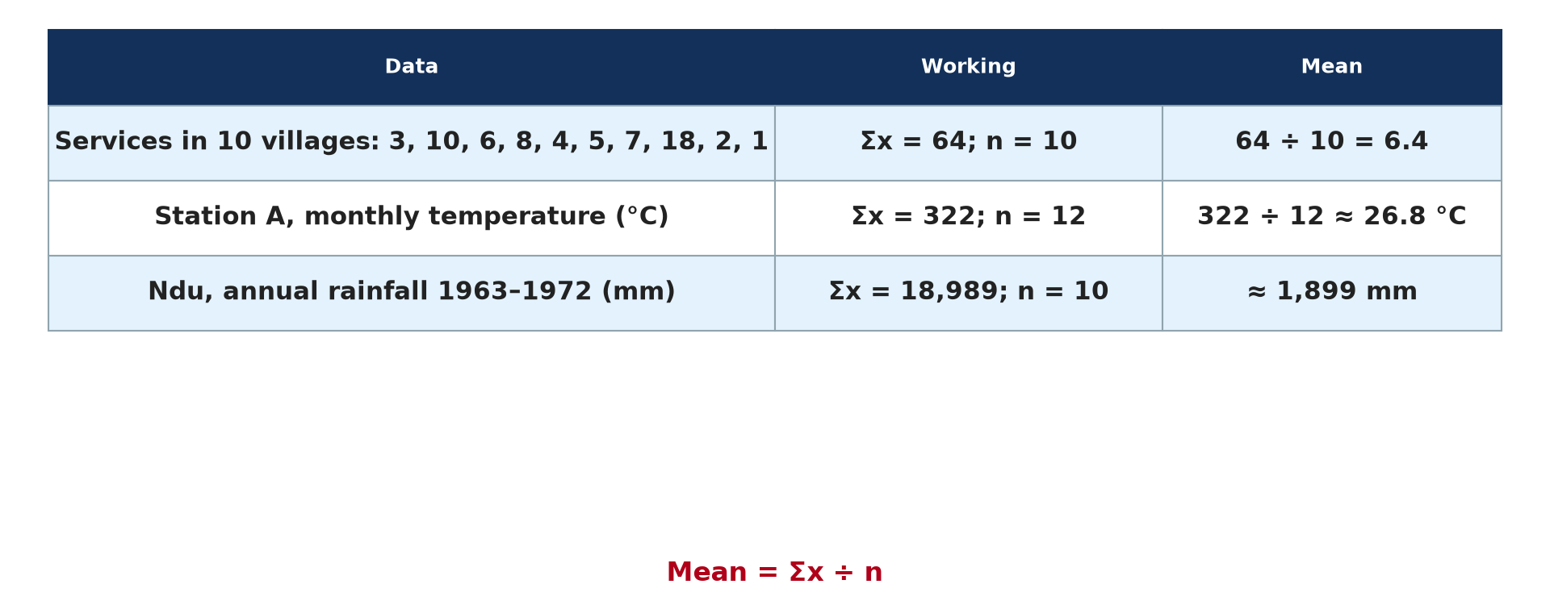
1. MEAN
Activity 1
Worked examples of the mean.
Notes:
Activity 1. Look carefully at this picture: worked examples of the mean. Observe every detail before I ask the question.

Slide 21
1. MEAN
Activity 1: Question
Calculate the mean of Oumarou's 9 farms (total = 192 bags).
Notes:
Here is the question for Activity 1: Calculate the mean of Oumarou's 9 farms (total = 192 bags). Take one minute to think and write your answer in your rough notebook.

Slide 22
1. MEAN
Activity 1: Answer
192 ÷ 9 ≈ 21.3 bags.
Notes:
Let us check the answer together. 192 ÷ 9 ≈ 21.3 bags.

Slide 23
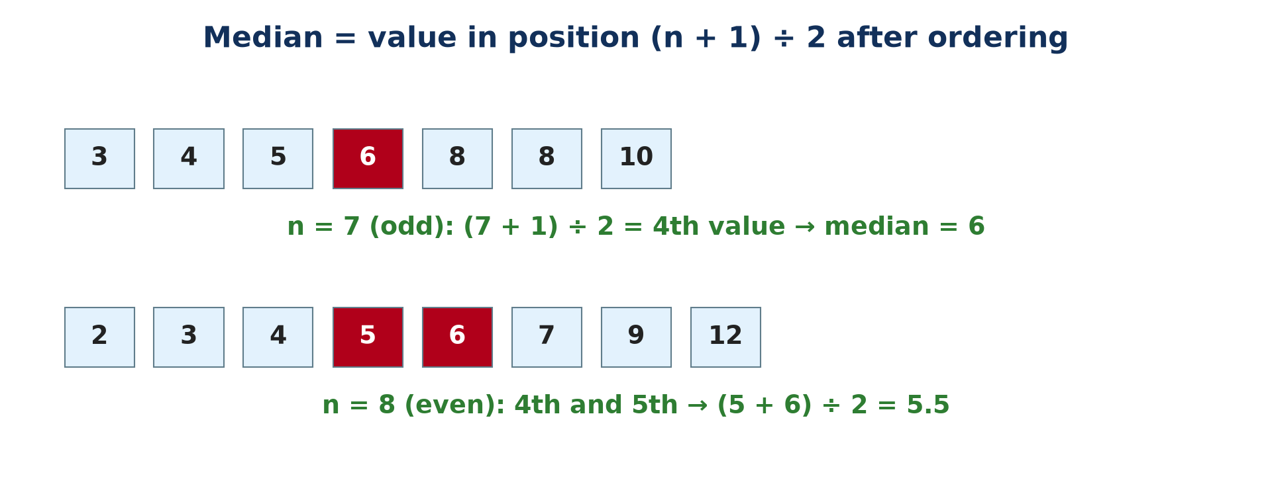
1. MEDIAN
Activity 2
Finding the median.
Notes:
Activity 2. Look carefully at this picture: finding the median. Observe every detail before I ask the question.

Slide 24
1. MEDIAN
Activity 2: Question
What is the median of Oumarou's farms (15, 16, 17, 18, 19, 20, 20, 22, 45)?
Notes:
Here is the question for Activity 2: What is the median of Oumarou's farms (15, 16, 17, 18, 19, 20, 20, 22, 45)? Take one minute to think and write your answer in your rough notebook.

Slide 25
1. MEDIAN
Activity 2: Answer
19 bags (the 5th value).
Notes:
Let us check the answer together. 19 bags (the 5th value).

Slide 26
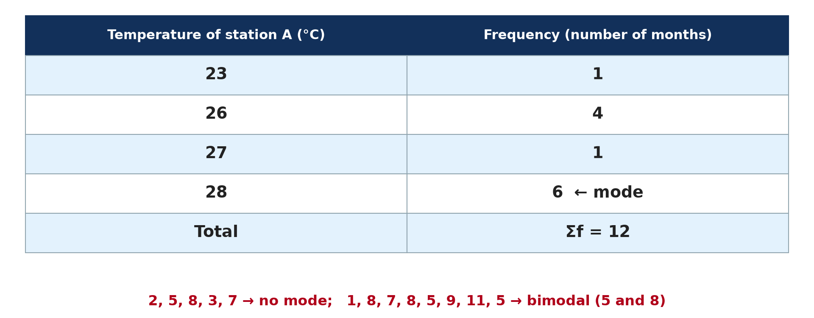
1. MODE
Activity 3
A frequency table.
Notes:
Activity 3. Look carefully at this picture: a frequency table. Observe every detail before I ask the question.

Slide 27
1. MODE
Activity 3: Question
What is the mode of Oumarou's farms?
Notes:
Here is the question for Activity 3: What is the mode of Oumarou's farms? Take one minute to think and write your answer in your rough notebook.

Slide 28
1. MODE
Activity 3: Answer
20 bags (it appears twice).
Notes:
Let us check the answer together. 20 bags (it appears twice).

Slide 29
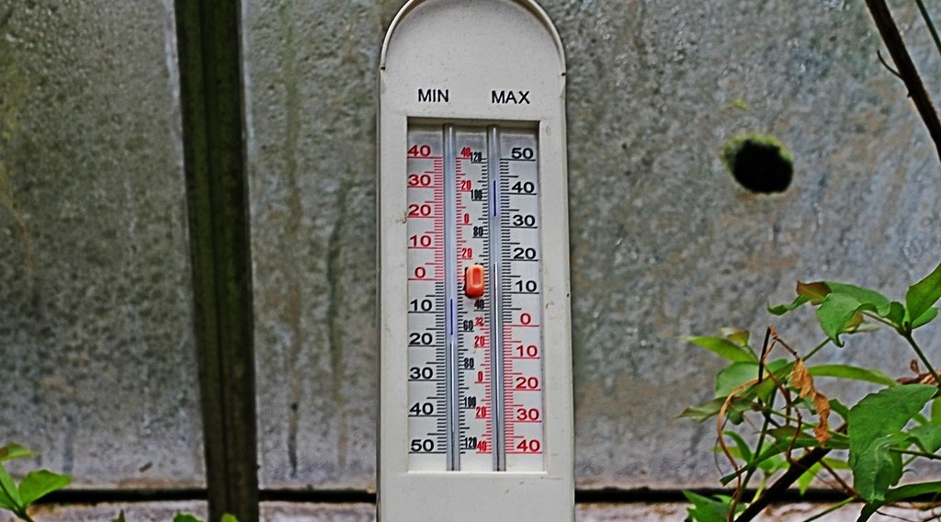
2. RANGE
Activity 4
A maximum and minimum thermometer.
Notes:
Activity 4. Look carefully at this picture: a maximum and minimum thermometer. Observe every detail before I ask the question.

Slide 30
2. RANGE
Activity 4: Question
Garoua's maxima for a week: 38, 40, 42, 37, 44, 41, 39 °C. What is the range?
Notes:
Here is the question for Activity 4: Garoua's maxima for a week: 38, 40, 42, 37, 44, 41, 39 °C. What is the range? Take one minute to think and write your answer in your rough notebook.

Slide 31
2. RANGE
Activity 4: Answer
44 − 37 = 7 °C.
Notes:
Let us check the answer together. 44 − 37 = 7 °C.

Slide 32
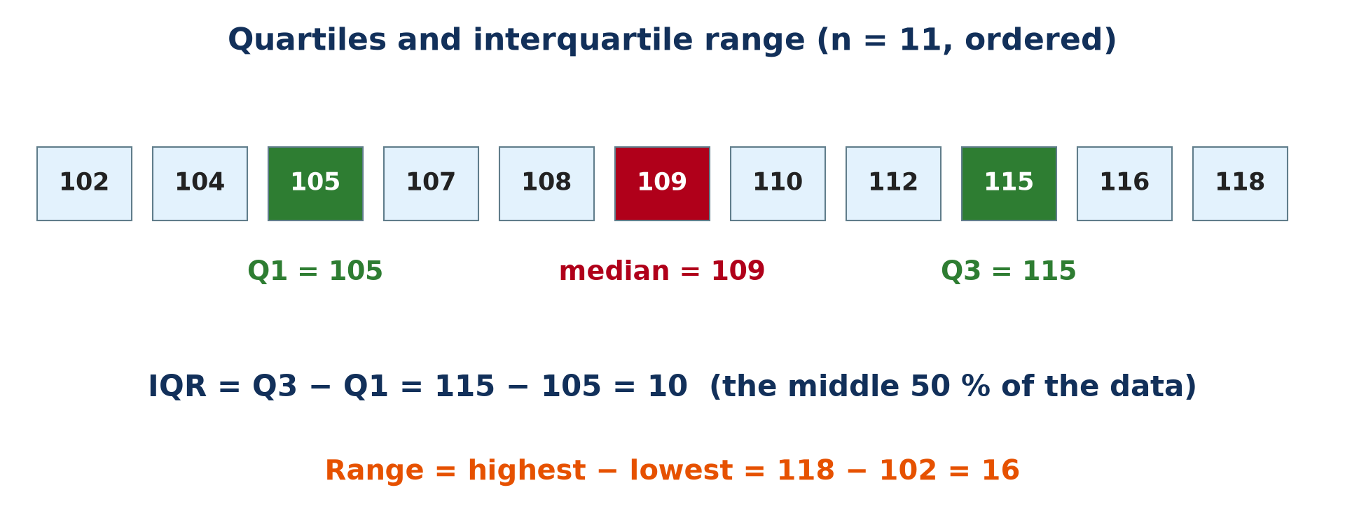
3. QUARTILES
Activity 5
Quartiles and IQR.
Notes:
Activity 5. Look carefully at this picture: quartiles and IQR. Observe every detail before I ask the question.

Slide 33
3. QUARTILES
Activity 5: Question
Why is the IQR better than the range when there is an outlier?
Notes:
Here is the question for Activity 5: Why is the IQR better than the range when there is an outlier? Take one minute to think and write your answer in your rough notebook.

Slide 34
3. QUARTILES
Activity 5: Answer
It ignores the lowest and highest 25 % of the values.
Notes:
Let us check the answer together. It ignores the lowest and highest 25 % of the values.

Slide 35
BOARD SUMMARY
Board Summary
Topic: Quantitative Techniques in Geography
Sub-topic: Statistical Techniques
Quantitative Techniques 3 (Part 1): Measures of Central Tendency, Range and Quartiles
Notes:
Now we are going to copy the board summary. Write the title and the headings neatly in your notebooks. I will give you enough time for each slide, so do not rush.

Slide 36
BOARD SUMMARY
DEFINITIONS
The key terms of this lesson are defined as follows:
Measures of central tendency: They are values that describe the centre or typical value of a set of data: the mean, the median and the mode.
Notes:
Let us copy the definitions. The key terms of this lesson are defined as follows. On this slide we have Measures of central tendency. Write each point on a new line, with the key term first, and explain it in your own words when we revise. When you finish, we go to the next slide.

Slide 37
BOARD SUMMARY
DEFINITIONS (continued)
Outlier: It is a value much higher or lower than the others.
Range: It is the difference between the highest and the lowest values.
Notes:
We continue with the definitions. On this slide we have Outlier and Range. Write each point on a new line, with the key term first, and explain it in your own words when we revise. When you finish, we go to the next slide.

Slide 38
BOARD SUMMARY
DEFINITIONS (continued)
Interquartile range (IQR): It is the difference between the upper and lower quartiles; it covers the middle 50 % of the data.
Notes:
We continue with the definitions. On this slide we have Interquartile range (IQR). Write each point on a new line, with the key term first, and explain it in your own words when we revise.

Slide 39
BOARD SUMMARY
1. Measures of Central Tendency
A) The Mean
The mean is calculated and assessed as follows:
Formula and example: Mean (x̄) = Σx ÷ n, where Σx is the sum of the values and n the number of values. For the services of 10 villages (3, 10, 6, 8, 4, 5, 7, 18, 2, 1), the mean is 64 ÷ 10 = 6.4 services.
Illustration: the mean
Notes:
Let us copy The Mean. The mean is calculated and assessed as follows. Copy the point on Formula and example on the left, then draw the diagram on the right: the mean. Give it a title and label it clearly.

Slide 40
BOARD SUMMARY
1. Measures of Central Tendency
A) The Mean
Example of station A: The twelve monthly temperatures of station A add up to Σx = 322. The mean temperature is therefore 322 ÷ 12 ≈ 26.8 °C.
Notes:
We continue with The Mean. Copy the point on Example of station A: write the key term first, then its explanation.

Slide 41
BOARD SUMMARY
1. Measures of Central Tendency
A) The Mean
Advantages: The mean is familiar, easy to understand and uses every value of the set. It is also needed to calculate the standard deviation.
Notes:
We continue with The Mean. Copy the point on Advantages: write the key term first, then its explanation.

Slide 42
BOARD SUMMARY
1. Measures of Central Tendency
A) The Mean
Disadvantages: It is distorted by outliers: for 3, 4, 5, 6 and 45 bags, the mean of 12.6 bags does not represent most farms. It may also not be an actual value and cannot be used for categories.
Notes:
We continue with The Mean. Copy the point on Disadvantages: write the key term first, then its explanation.

Slide 43
BOARD SUMMARY
1. Measures of Central Tendency
B) The Median
The median is found and assessed as follows:
Method: Put the values in order, then take the value in position (n + 1) ÷ 2. The median is the middle value of the set.
Illustration: the median
Notes:
Let us copy The Median. The median is found and assessed as follows. Copy the point on Method on the left, then draw the diagram on the right: the median. Give it a title and label it clearly.

Slide 44
BOARD SUMMARY
1. Measures of Central Tendency
B) The Median
Odd and even numbers of values: For 3, 4, 5, 6, 8, 8, 10, the position is (7 + 1) ÷ 2 = 4th, so the median is 6. For 2, 3, 4, 5, 6, 7, 9, 12, the median is the mean of the 4th and 5th values, (5 + 6) ÷ 2 = 5.5.
Notes:
We continue with The Median. Copy the point on Odd and even numbers of values: write the key term first, then its explanation.

Slide 45
BOARD SUMMARY
1. Measures of Central Tendency
B) The Median
Example of Ndu (1963 to 1972): The annual rainfalls of the ten years are put in order. The 5th and 6th values are 1,942 and 1,904 mm, so the median is 1,923 mm.
Notes:
We continue with The Median. Copy the point on Example of Ndu (1963 to 1972): write the key term first, then its explanation.

Slide 46
BOARD SUMMARY
1. Measures of Central Tendency
B) The Median
Advantages and disadvantages: The median is easy to find and is not affected by outliers. However, it ignores most values and is slow to find for large sets.
Notes:
We continue with The Median. Copy the point on Advantages and disadvantages: write the key term first, then its explanation.

Slide 47
BOARD SUMMARY
1. Measures of Central Tendency
C) The Mode
The mode is found and assessed as follows:
Method and example: The mode is the most frequent value, found by counting with a frequency table. At station A, 28 °C occurs in 6 months, so the mode is 28 °C.
Illustration: the mode
Notes:
Let us copy The Mode. The mode is found and assessed as follows. Copy the point on Method and example on the left, then draw the diagram on the right: the mode. Give it a title and label it clearly.

Slide 48
BOARD SUMMARY
1. Measures of Central Tendency
C) The Mode
Special cases: The set 2, 5, 8, 3, 7, 4, 11 has no mode, because no value is repeated. The set 1, 8, 7, 8, 5, 9, 11, 5 has two modes, 5 and 8, and is called bimodal.
Notes:
We continue with The Mode. Copy the point on Special cases: write the key term first, then its explanation.

Slide 49
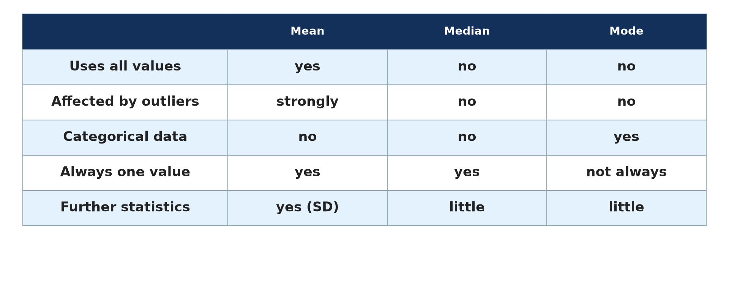
BOARD SUMMARY
1. Measures of Central Tendency
C) The Mode
Advantages and disadvantages: The mode can be used for categories, such as soil types or means of transport, and is not affected by outliers. However, there may be no mode or several, and it ignores the other values.
Illustration: comparing the three measures
Notes:
Copy the point on Advantages and disadvantages on the left, then draw the diagram on the right: comparing the three measures. Give it a title and label it clearly.

Slide 50
BOARD SUMMARY
2. The Range
The range is calculated and assessed as follows:
Formula and example: Range = highest value − lowest value. For the maximum temperatures of Garoua in a week (38, 40, 42, 37, 44, 41, 39 °C), the range is 44 − 37 = 7 °C.
Illustration: a maximum and minimum thermometer
Notes:
Let us copy The Range. The range is calculated and assessed as follows. Copy the point on Formula and example on the left, then draw the diagram on the right: a maximum and minimum thermometer. Give it a title and label it clearly.

Slide 51
BOARD SUMMARY
2. The Range
Interpretation and assessment: A large range shows widely spread data, while a small range, such as 28 − 23 = 5 °C at station A, shows clustered data. The range is simple and quick, but it uses only the two extreme values and is misled by outliers.
Notes:
We continue with The Range. Copy the point on Interpretation and assessment: write the key term first, then its explanation.

Slide 52
BOARD SUMMARY
3. Quartiles and the Interquartile Range
The quartiles and the interquartile range are calculated as follows:
Steps: Put the data in order and find the median (Q2). The lower quartile (Q1) is the median of the lower half, the upper quartile (Q3) is the median of the upper half, and IQR = Q3 − Q1.
Illustration: quartiles
Notes:
Let us copy Quartiles and the Interquartile Range. The quartiles and the interquartile range are calculated as follows. Copy the point on Steps on the left, then draw the diagram on the right: quartiles. Give it a title and label it clearly.

Slide 53
BOARD SUMMARY
3. Quartiles and the Interquartile Range
Example 1 (n = 11): For eleven values from 102 to 118, the median is 109, Q1 is 105 and Q3 is 115. The interquartile range is 115 − 105 = 10.
Notes:
We continue with Quartiles and the Interquartile Range. Copy the point on Example 1 (n = 11): write the key term first, then its explanation.

Slide 54
BOARD SUMMARY
3. Quartiles and the Interquartile Range
Example 2 (n = 13): For 10, 25, 30, 30, 40, 41, 42, 50, 55, 70, 101, 110, 111, the median is 42 and Q1 = (30 + 30) ÷ 2 = 30. Q3 = (70 + 101) ÷ 2 = 85.5, so the IQR is 85.5 − 30 = 55.5.
Notes:
We continue with Quartiles and the Interquartile Range. Copy the point on Example 2 (n = 13): write the key term first, then its explanation.

Slide 55
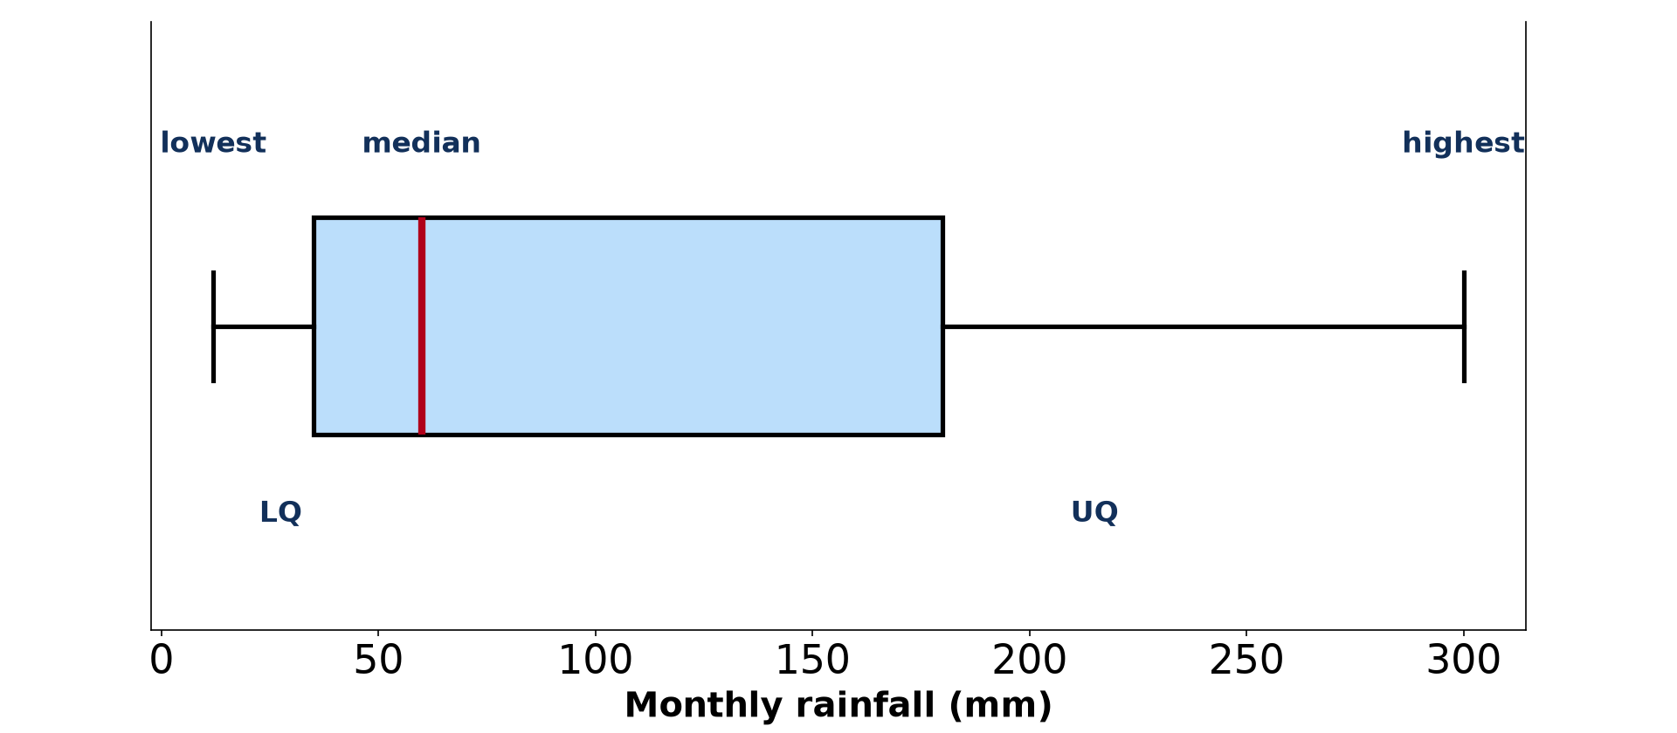
BOARD SUMMARY
3. Quartiles and the Interquartile Range
Advantage: The IQR covers the middle 50 % of the data and ignores the lowest and highest quarters. It is therefore not affected by outliers, unlike the range.
Illustration: a box and whisker plot
Notes:
Copy the point on Advantage on the left, then draw the diagram on the right: a box and whisker plot. Give it a title and label it clearly.

Slide 56
FORMATIVE EVALUATION
Evaluation 1
Find the mean, median and mode of 4, 7, 7, 9, 13.
Notes:
Now let us check what you have understood. Question 1: Find the mean, median and mode of 4, 7, 7, 9, 13. Answer in your exercise book.

Slide 57
FORMATIVE EVALUATION
Expected Answer
Mean = 40 ÷ 5 = 8; median = 7; mode = 7.
Notes:
The expected answer is: mean = 40 ÷ 5 = 8; median = 7; mode = 7. If you got it right, well done.

Slide 58
FORMATIVE EVALUATION
Evaluation 2
Why is the median better than the mean for Oumarou's farms?
Notes:
Now let us check what you have understood. Question 2: Why is the median better than the mean for Oumarou's farms? Answer in your exercise book.

Slide 59
FORMATIVE EVALUATION
Expected Answer
The outlier (45 bags) raises the mean to about 21.3, while the median (19) represents most farms.
Notes:
The expected answer is: the outlier (45 bags) raises the mean to about 21.3, while the median (19) represents most farms. If you got it right, well done.

Slide 60
REMEDIATION
Remediation
Fill in the blanks:
Mean = Σx ÷ ______.
The most frequent value is the ______.
IQR = Q3 − ______.
Notes:
For those who need more practice, fill in the blanks in your exercise book. The answers are: number 1, n; number 2, mode; number 3, Q1.

Slide 61
HOMEWORK
Homework
Calculate the mean of 3, 5, 7 and 9.
Notes:
For your homework: Calculate the mean of 3, 5, 7 and 9. We shall correct it at the beginning of our next lesson.

Slide 62
NEXT LESSON
Next Lesson
Our next lesson will be on:
Quantitative Techniques 3 (Part 2): Measures of Dispersion: Variance, Standard Deviation and Coefficient of Variation
Notes:
Our next lesson will be on Quantitative Techniques 3 (Part 2): Measures of Dispersion: Variance, Standard Deviation and Coefficient of Variation. Thank you for your attention, and see you next time.

Slide 63
BILINGUAL GAME
Bilingual Game (Jeu Bilingue)
English | Français
Mean | La moyenne
Median | La médiane
Mode | Le mode
Range | L'étendue
Quartile | Le quartile
Outlier | La valeur aberrante
Notes:
Let us play the bilingual game. I say a word in English, and you give me the French word. Then we do the reverse.

Slide 64
LOGBOOK
Official Logbook (1/2)
Module / Topic | Quantitative Techniques in Geography
Lesson Title | Quantitative Techniques 3 (Part 1): Measures of Central Tendency, Range and Quartiles
Expected Learning Outcomes | Calculate the mean and state its advantages and disadvantages. Find the median of odd and even sets of data. Find the mode and recognise bimodal data. Calculate the range. Calculate the quartiles and the interquartile range.
Competence | Learners are able to calculate and interpret the mean, median, mode, range and interquartile range of geographical data.
Notes:
I record this information in the official logbook of the class after the lesson.

Slide 65
LOGBOOK
Official Logbook (2/2)
Matter Taught | DEFINITIONS; The Mean; The Median; The Mode; The Range; Quartiles and the Interquartile Range.
Evaluation | Formative evaluation and remediation exercise.
Homework | Calculate the mean of 3, 5, 7 and 9.
Enrolment / Present / Absent | ____ / ____ / ____
Achievement | To be completed after the lesson.
Notes:
I complete the second page of the logbook: the matter taught, the evaluation, the homework and the attendance.

Slide 66
TEACHER'S NOTE
Teacher's Note
Timing: Homework correction, plan, objectives 8 min | Recall, situation, action 10 min | 5 activities 30 min | Board summary (copying) 30 min | Evaluation, remediation 10 min | Homework, next lesson 5 min | Logbook 7 min
Without the projector (Activity 1): add the values on the board.
Without the projector (Activity 2): order the values.
Without the projector (Activity 3): make a tally table.
Without the projector (Activity 4): find the highest and lowest.
Without the projector (Activity 5): split the ordered data in halves.
Notes:
This slide is for me, the teacher: it gives the timing of the lesson and what to do if the projector is not available.

Slide 67
REFERENCES
References
Geography Syllabus for Sixth Forms (Lower and Upper Sixth), MINESEC, 2019 — Module 8 (Practical Geography).
Teacher's course notes: Mr KAMDEM E., Statistical Techniques in Geographical Analysis (USA), GBHS Garoua, 2026.
Photo, Activity 4: “maximum minimum thermometer” by Leo Reynolds, CC BY-NC-SA 2.0, via Flickr (https://www.flickr.com/photos/49968232@N00/7928521796)
Diagrams and animations: drawn for this lesson (Geography Department).
Notes:
These are the references and picture credits used to prepare this lesson.

